Slide 1
Machine learning with Predictive Analysis
Mahalete Haile
Haritha Nayani
Geetanjali Sahoo
Venu Voleti

Slide 2
Data Description
The 20 Newsgroup dataset is a collection of around 18000 newsgroups posts.
The file also contains 20 files that contains all of the documents, one document per newsgroup.
The 20 newsgroup data collection is a popular data set to experiment machine learning techniques such as text classification and text clustering.

Slide 3
Data processing
Data is split into in-sample called the training set and out of-sample called the test set.
In order to convert the text files into numerical feature vectors. We achieve this through a high level component in Scikit-learn called Count Vectorizer. by doing ‘count_vect.fit_transform(Text_train)’, we are learning the vocabulary dictionary and it returns a Document-Term matrix. [n_samples, n_features].

Slide 4
Classifiers
We have used three classifiers to implement the supervised algorithm which are
Logistic Regression
MultinomailNB
SVM classifier

Slide 5
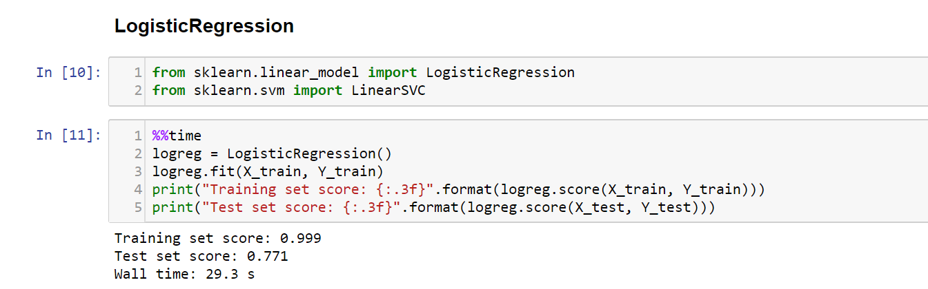
Classifier 1:Logistic Regression
Logistic Regression is a Go-to as a first algorithm to try in linear regression
Training set is overfit .
Notes:
we used

Slide 6
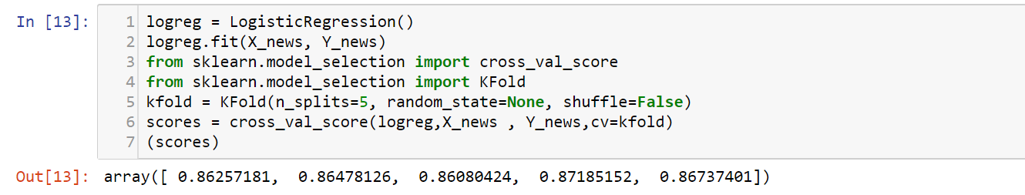
Logistic regression cross validation
Notes:
Cross-validation is a method for robustly estimating test-set performance (generalization) of a model

Slide 7
MultinomialNB
Coming under Naïve Bayes Classification, MultinomialNB tends to be faster in training. They learn parameters by looking at each feature individually and collect simple per class statistics from each feature.
Super simple and less training data is required.
Mostly used for text data and with large documents
Performance generalization is good and processing time is less .

Slide 8
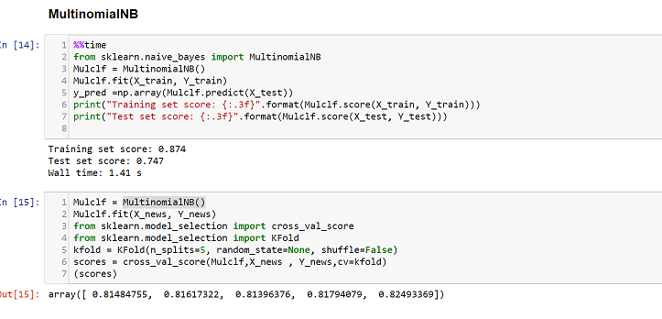
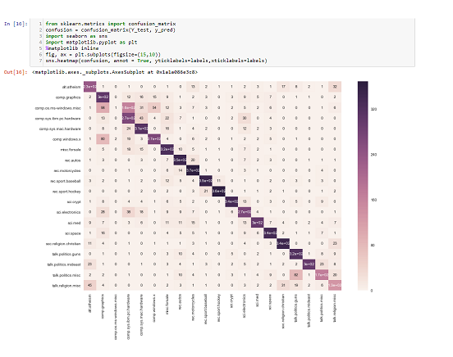
MultinomialNB

Slide 9
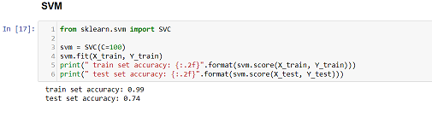
SVM Classifier
The SVM classifier is known for its high accuracy, nice theoretical guarantee with respect to over fitting.
Works well even if your data isn’t linearly separable in the base feature space.

Slide 10
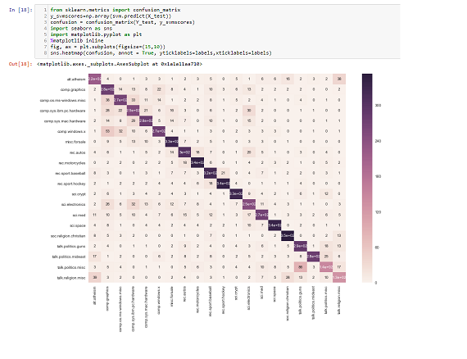
Confusion matrix of SVM classifier

Slide 11
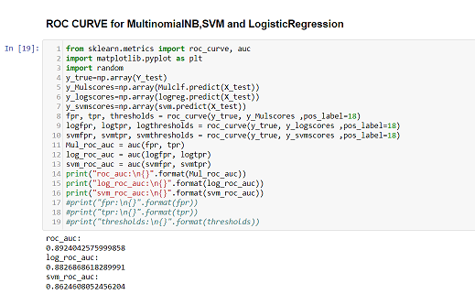
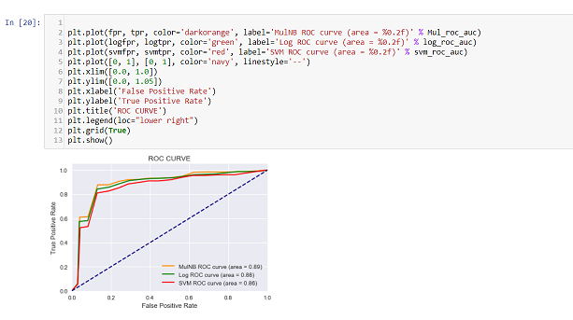
ROC curve
Notes:
ROC Area: – 1.0: perfect prediction – 0.9: excellent prediction – 0.8: good prediction – 0.7: mediocre prediction – 0.6: poor prediction – 0.5: random prediction – <0.5: something wrong!

Slide 12
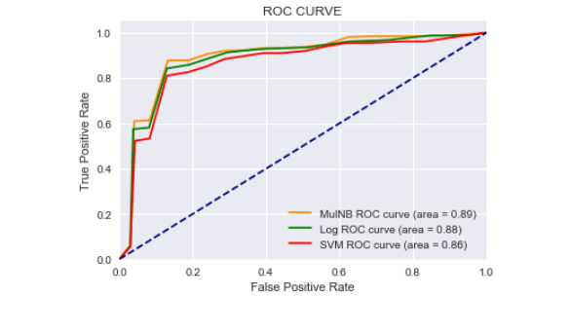
ROC Curve
ROC Area
1.0: perfect prediction
0.9: excellent prediction
0.8: good prediction
0.7: mediocre prediction
0.6: poor prediction
0.5: random prediction
<0.5: something wrong!

Slide 13
Pipeline & GridSearch
Pipeline:It will chain multiple estimators into one.
By calling fit and predict once on the data we can fit a whole sequence of estimators.
We can Grid search over parameters of all estimators in the pipeline at once.
Pipelines help avoid leaking statistics from your test data into the trained model in cross-validation,by ensuring that the same samples are used to train the transformers and predictors.
Grid Search:-systematically working through multiple combinations of parameter tunes, cross validate each and determine which one gives the best performance.You can work through many combination only changing parameters a bit.

Slide 14
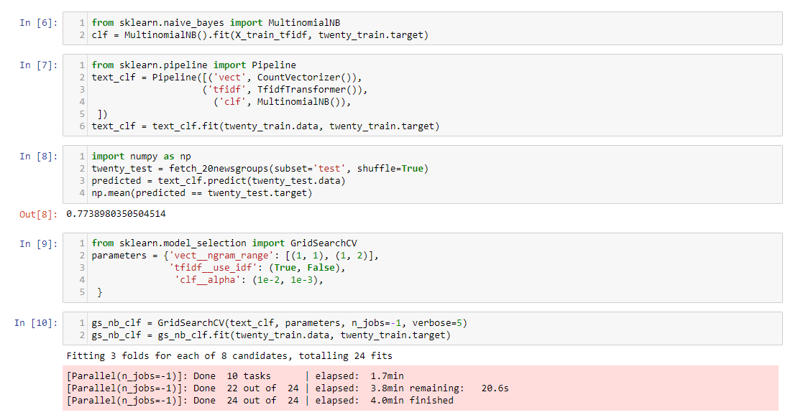
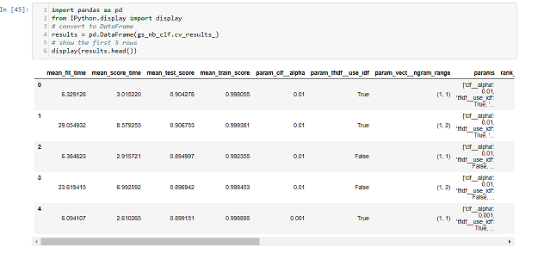
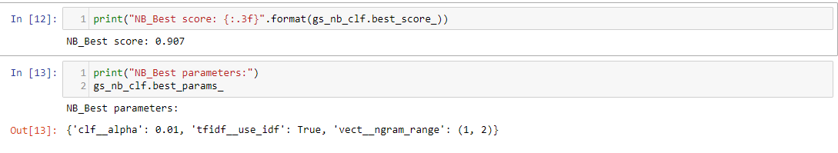
Pipeline and GridSearchCV
Notes:
clf__alpha: float, optional (default=1.0),Additive (Laplace/Lidstone) smoothing parameter (0 for no smoothing).
tfidf__use_idf:-
vect__ngram_range: tuple (min_n, max_n),The lower and upper boundary of the range of n-values for different n-grams to be extracted. All values of n such that min_n <= n <= max_n will be used.

Slide 15
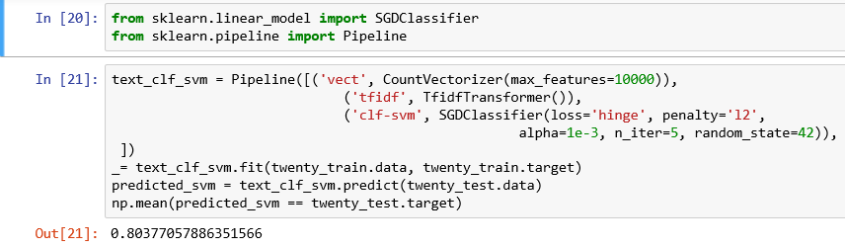
GRID SEARCH SVM
Notes:
clf-svm__alpha':--, 'vect__min_df': --- 'vect__ngram_range': --- tuple (min_n, max_n),The lower and upper boundary of the range of n-values for different n-grams to be extracted. All values of n such that min_n <= n <= max_n will be used.

Slide 16
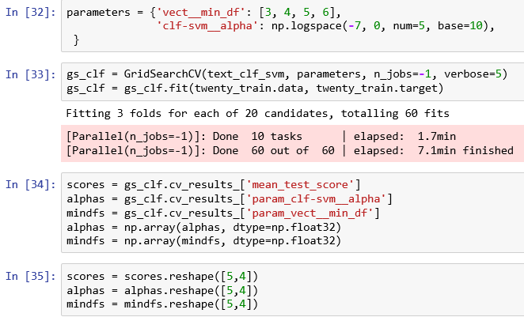
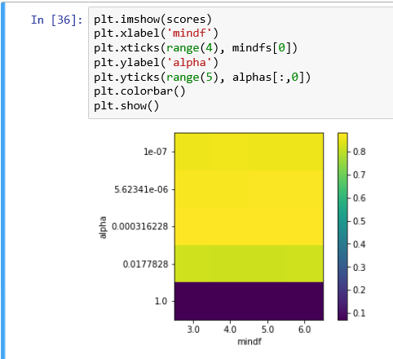

Slide 17
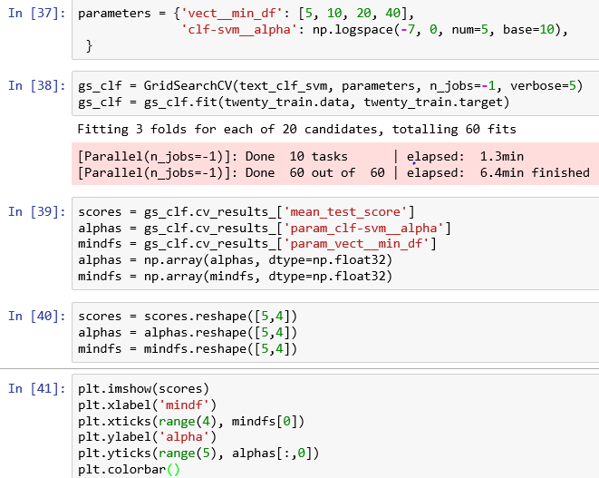
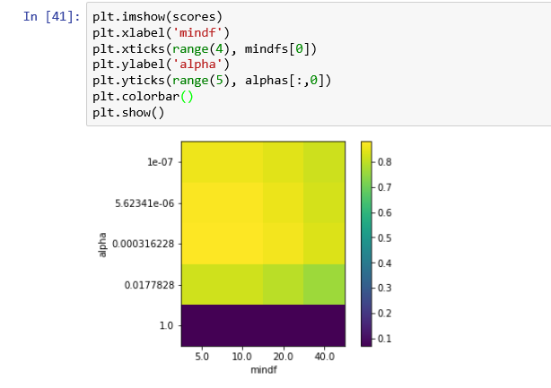

Slide 18
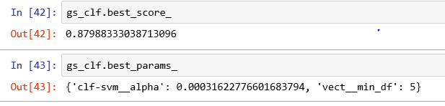

Slide 19
THANKS

